Slide 1

Retro Rider
By: Diego, Ahmad and Adel

Slide 2

What is the game?
Infinite Subway Surfer’s style game but in a synthwave theme

Slide 3

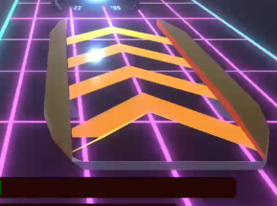





Powerups:
Shield
Boost
Jump
Obstacles:
Barricades
Police Cars
Laser Gates
Garbage Trucks

Slide 4
Design Patterns
Singleton: Ensures only one InputManager, UIManager, AudioManager, and HealthSystem
Observer: HUD and SFX update when player health changes
Factory: LevelSpawner dynamically creates random level blocks
Chain of Responsibility: Handles progressive damage (visual feedback on the car)
Strategy (Modified): Each level defines its own obstacle/powerup layout logic

Slide 5

Teaser Trailer

Slide 6

Thank you!

